Slide 1
Art Generation
With GAN
By: Dylan, Eric, Lam, Manny, Andrew

Slide 2
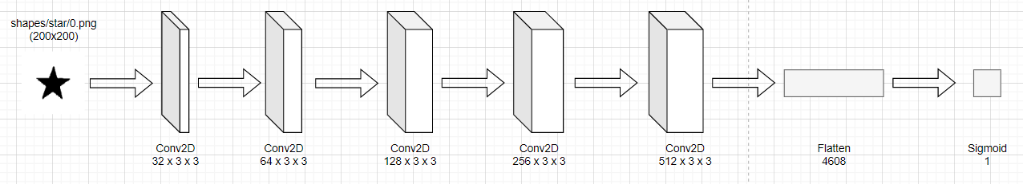
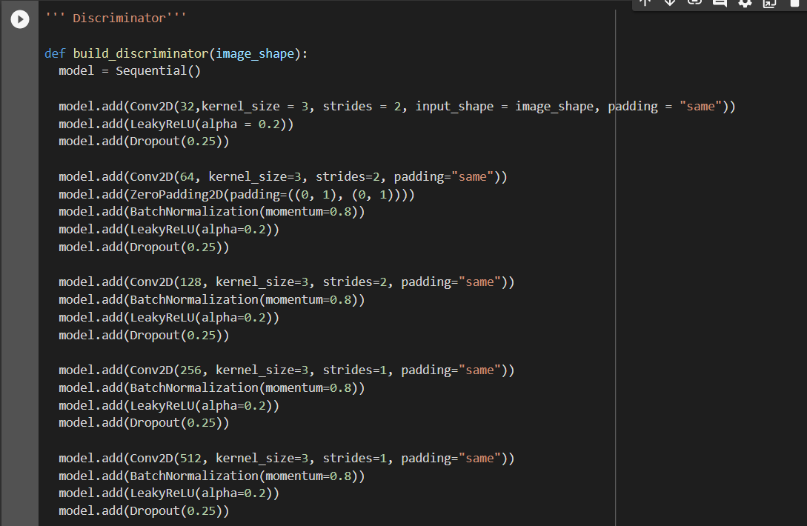
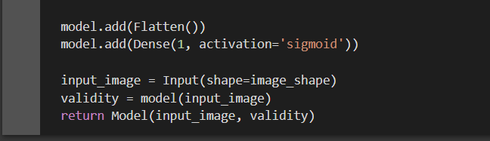
Discriminator
Layers increase to allow capture of larger combinations of patterns
Leaky ReLu used to help gradient flow easier
Might want to test different activation functions to obtain better results for certain data sets
Experiment with kernel_size
Observation that other GAN networks change their kernel size and at different layers

Slide 3
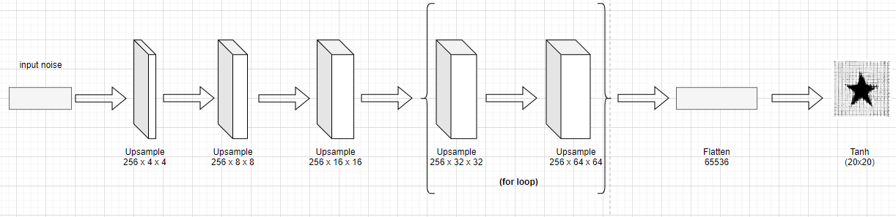
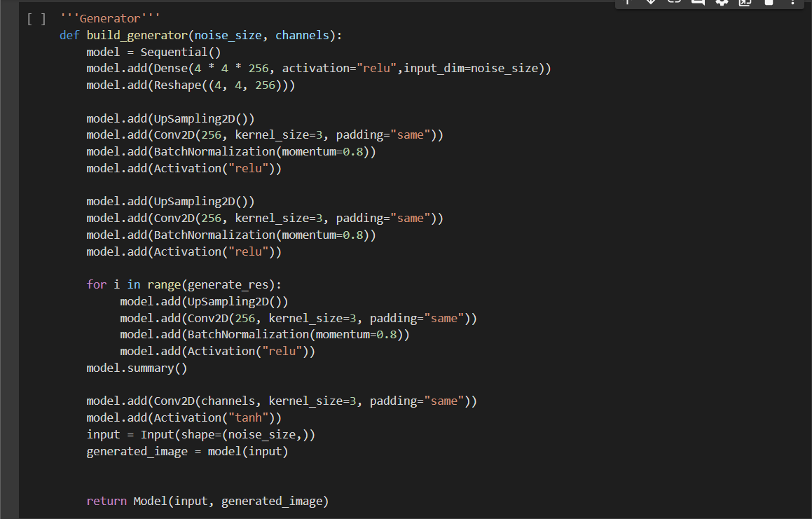
Generator
Layers stay the same, but we are increasing the kernel size at an exponential rate
UpSampling2D() doubles the dimensions of the input
For loop to iterate for value of generate_res
ReLU is used instead of leaky ReLU
This is to solve the issue of having vanishing gradients
Promotes sparse activations as well to ensure calculator integrity
Notes:
Generator code. Takes noise created from discriminator and upsamples 3 iterations. For loop for more iterations done for any value in the variable “generate_res”. Flatten = 256 x 16 x 16 which is the last upsample before the for loop. Tanh produces our og 20 x 20.

Slide 4
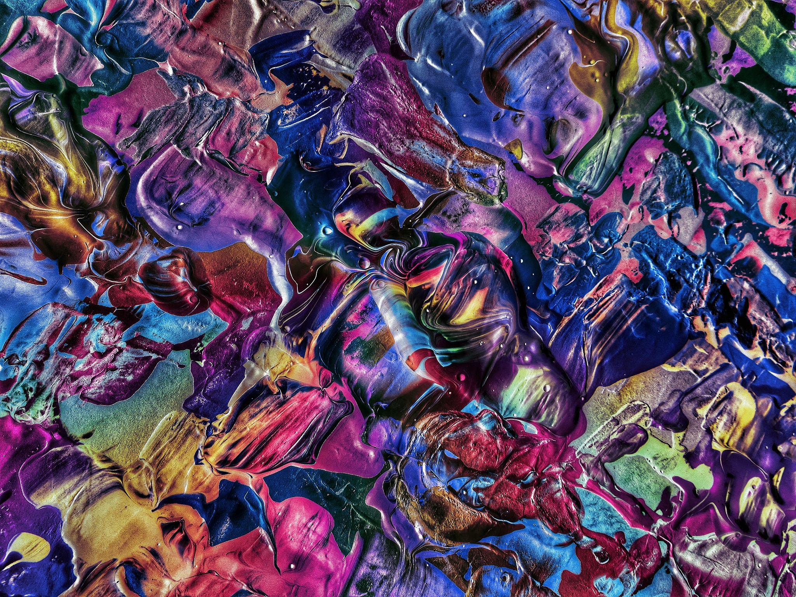
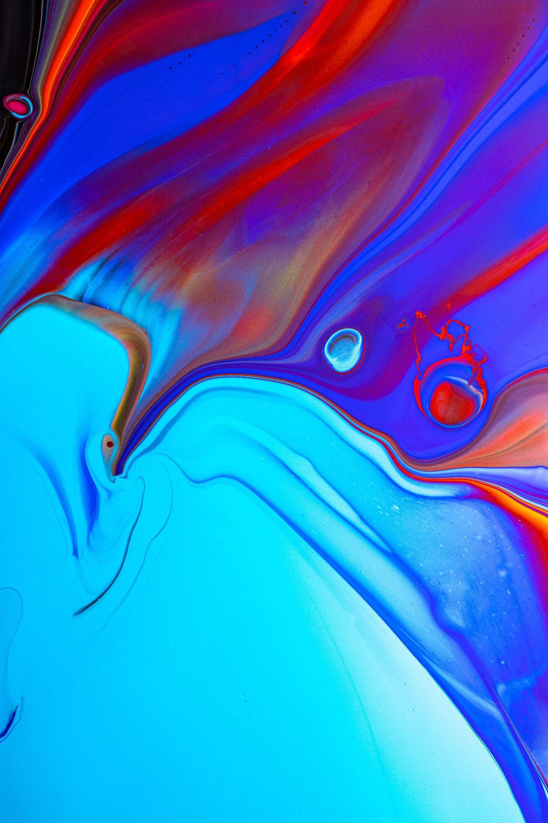
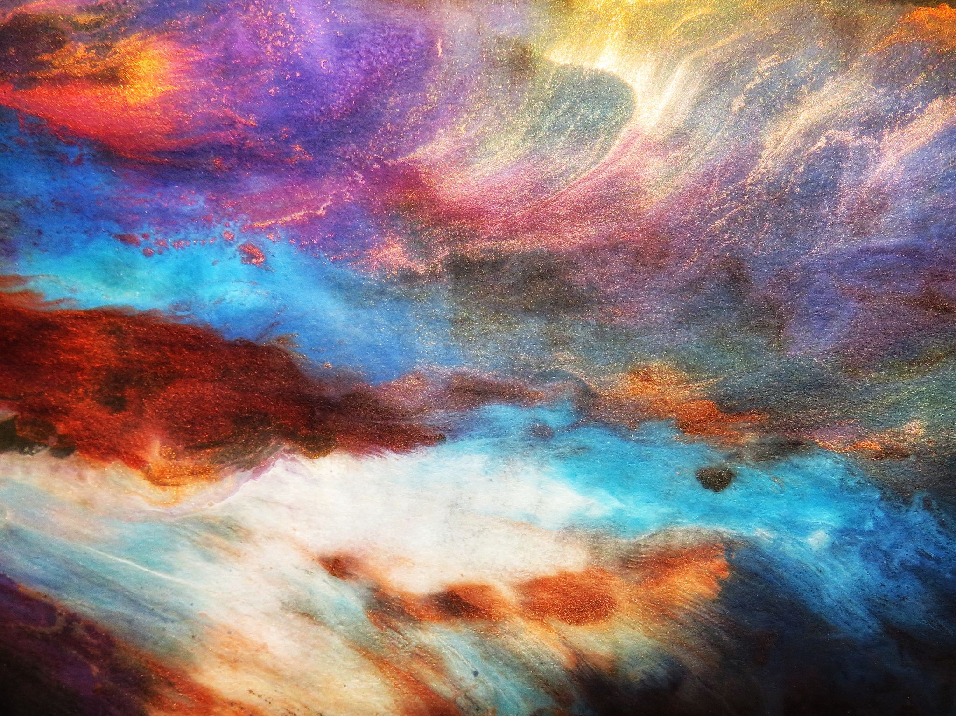
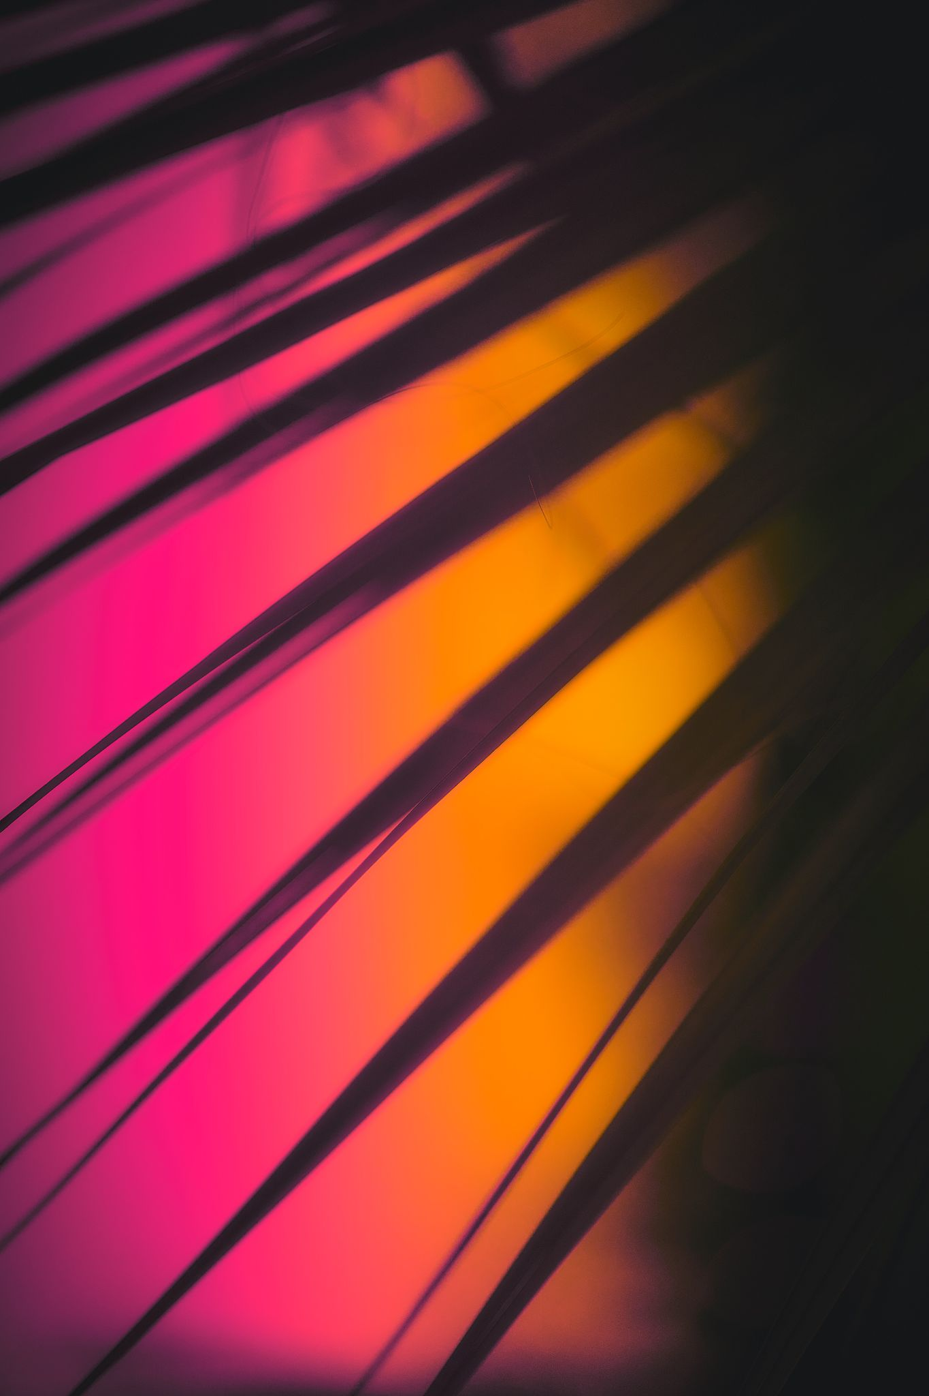
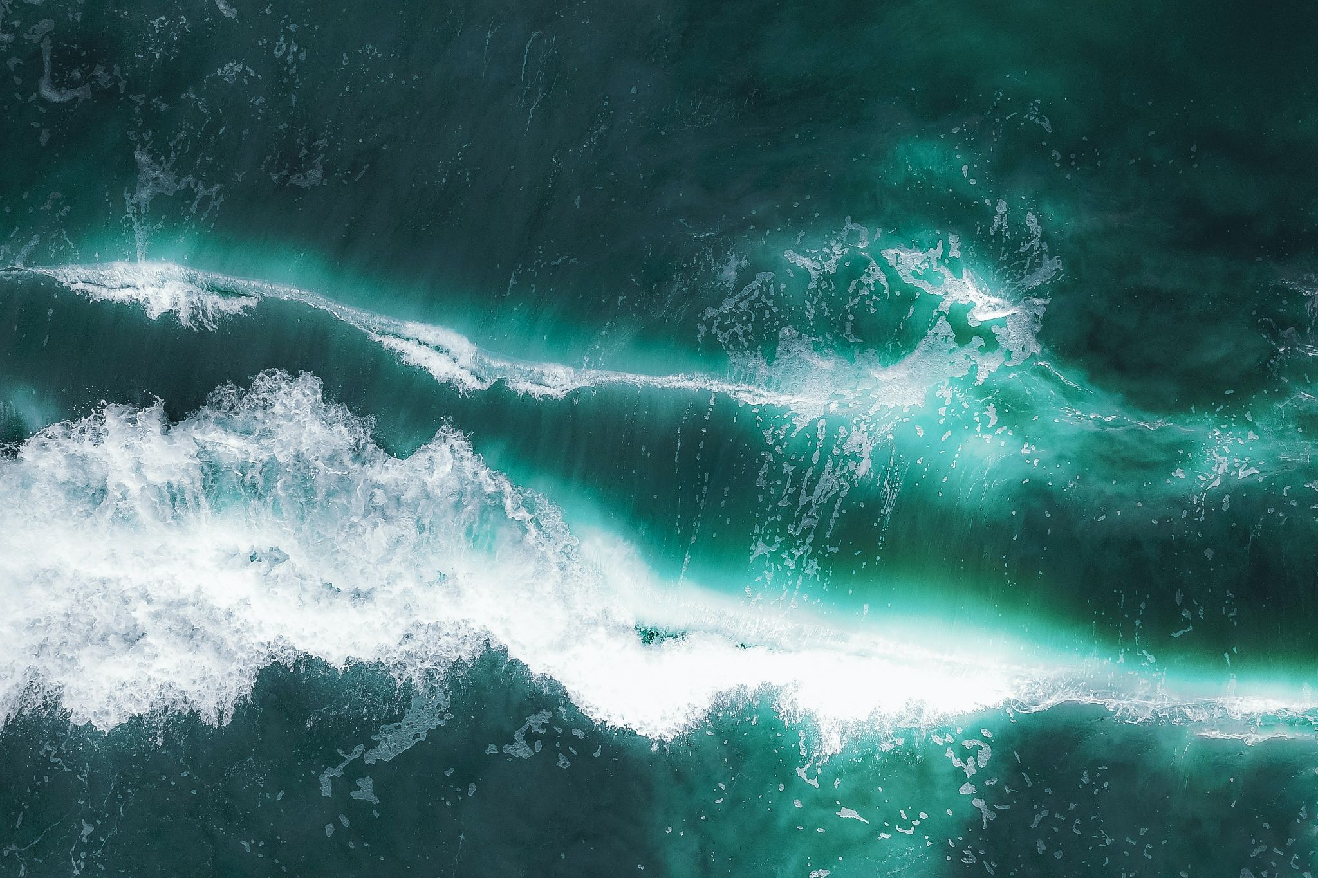
Limitations & Roadblocks
Batch size
Image size
Color output
Diversity of dataset images
Examples from Art Gallery dataset

Slide 5

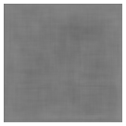
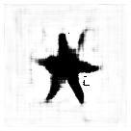
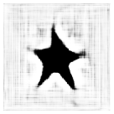
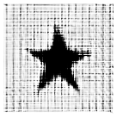
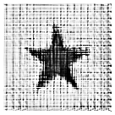
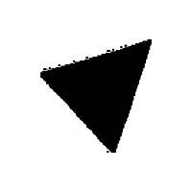
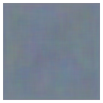
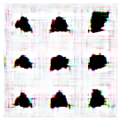
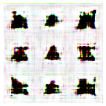
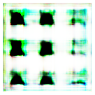
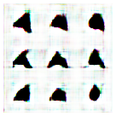

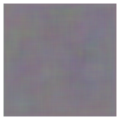
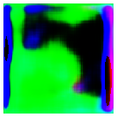
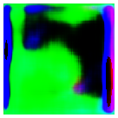
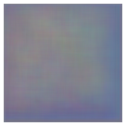
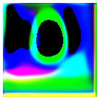
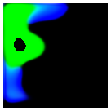
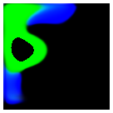
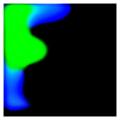
Results

Slide 6
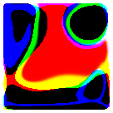
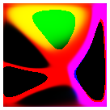
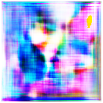
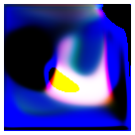
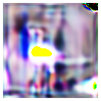
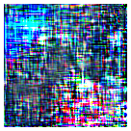
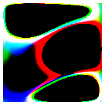
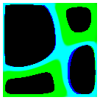
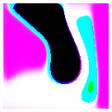
Best Outputs

Slide 7
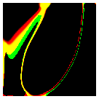
What’s Next
Refine Hyperparameters / Cost Function / Add Labels
Attempt to either run locally or upgrade permissions in colab
Faster runtime
Train higher resolution images
Utilization of more demanding activation layers / components
Overall lower discriminator accuracy
3D shapes / Abstract Imagery Implementation
Abstract imagery oftentimes uses lines and basic shapes to express feelings / ideologies

